Slide 1
Infinity
What is it and Who cares?

Slide 2
Why Me?
That’s a good question.

Slide 3
Repeated Numbers
3, 4, 7, 12, 40, …

Slide 4
A Bigger “Number”
Not even in the Bible

Slide 5
Indirectly Used
Eternity, Everlasting, All knowing, All powerful, Ever present, …

Slide 6
∞
What is it? How big is it?

Slide 7
Wow, That’s Big
Yes. It is.

Slide 8
Some Math Terminology
R = The set of all real numbers.
+ = Addition
- = Subtraction
* = Multiplication
/ = Division
= = Equals

Slide 9
Infinite Identities
∞ + R = ∞
∞ - R = ∞
∞ / R = ∞
R / ∞ = 0
∞ * R = ∞

Slide 10
The Great Simplification
$$\frac{a^{4}+3a^{3}b+12ab^{3}+60b^{2}}{ac^{2}+3c+b}$$

Slide 11
Statistics and Heaven
Everyone’s favourite combination.

Slide 12
Expected Value

Slide 13
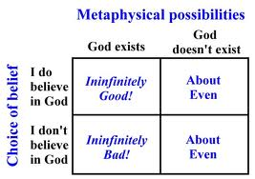
Pascal’s Wager

Slide 14
Expected Value of Heaven?
Incalculable. Literally.

